Slide 1
Travel PLANNER agent
CAPSTONE PROJECT
Presented By : DINESH
Student name : DINESH
College Name & Department : GURUGRAM UNIVERSITY
BTECH COMPUTER SCIENCE & ENGINEERING

Slide 2
OUTLINE
Problem Statement
Technology used
Wow factor
End users
Result
Conclusion
Git-hub Link
Future scope
IBM Certifications

Slide 3
Problem Statement
A Travel Planner Agent is an AI-powered assistant that helps users plan trips efficiently and intelligently.
It uses real-time data to suggest destinations, build itineraries, and recommend transport and accommodation options.
By understanding user preferences, budgets, and constraints, it tailors personalized travel plans. Integrated with maps, weather updates, and local guides, it ensures a smooth travel experience.
The agent can also manage bookings, alert users to changes, and optimize schedules on the go.
This smart assistant transforms complex travel planning into a seamless, enjoyable process.

Slide 4
Technology used
IBM cloud lite services
IBM Granite model
IBM Cloud Watsonx AI Studio
IBM Cloud Watsonx AI runtime

Slide 5
IBM cloud services used
IBM Cloud Watsonx AI Studio
IBM Cloud Watsonx AI runtime
IBM Cloud Agent Lab
IBM Granite foundation model

Slide 6
Wow factors
Personalized Itineraries with AI
The agent builds day-by-day plans based on user preferences, budget, and travel dates — not just generic suggestions.
Real-Time Data Integration
Integrated with weather updates and (optionally) Google Maps to adapt plans dynamically.
Built Using IBM Watson + Granite
Uses Watson Assistant for natural conversation, and Granite LLM (optional) for smarter trip responses or summaries.
Smart Schedule Optimization
Automatically arranges attractions based on opening hours, travel time, and user preferences.
One-Stop Travel Planning
From destination search to itinerary + bookings + alerts — all managed by one AI-powered assistant.
Hosted Fully on IBM Cloud (Lite)
Serverless deployment using IBM Code Engine, cloud-native and scalable — even on free tier.

Slide 7
End users
Target Users: 🔹 Tourists, Students, Families, Business Travelers
What They Gain: ✅ AI-powered trip planning in minutes ✅ One-stop solution for destinations, travel, and stay ✅ Real-time updates and personalized itineraries ✅ Easy-to-use chatbot assistant for planning on the go

Slide 8
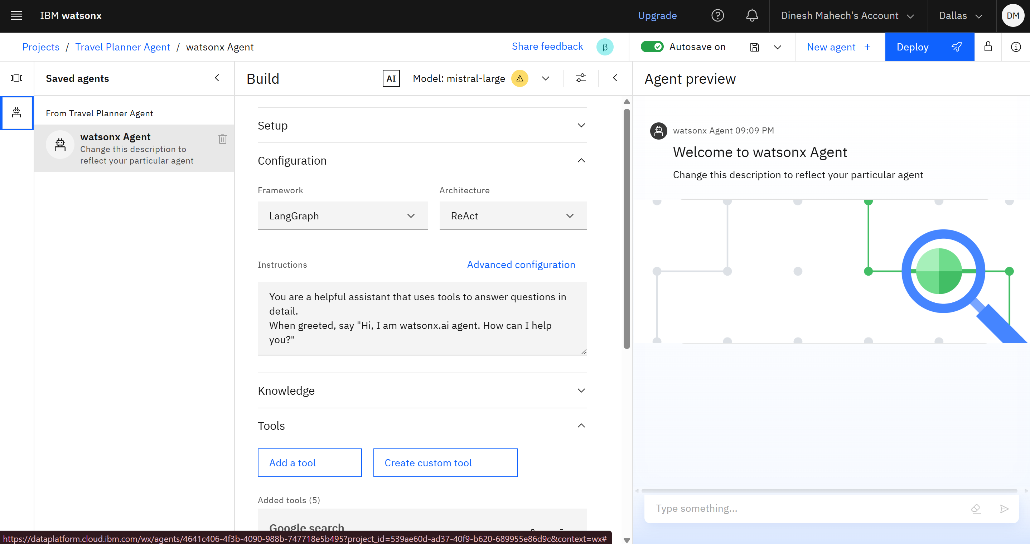
Results

Slide 9
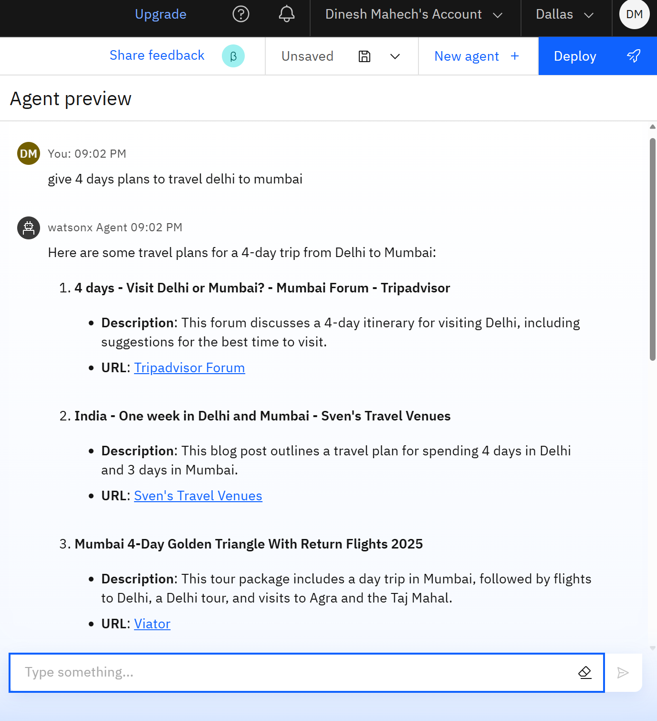
Results

Slide 10
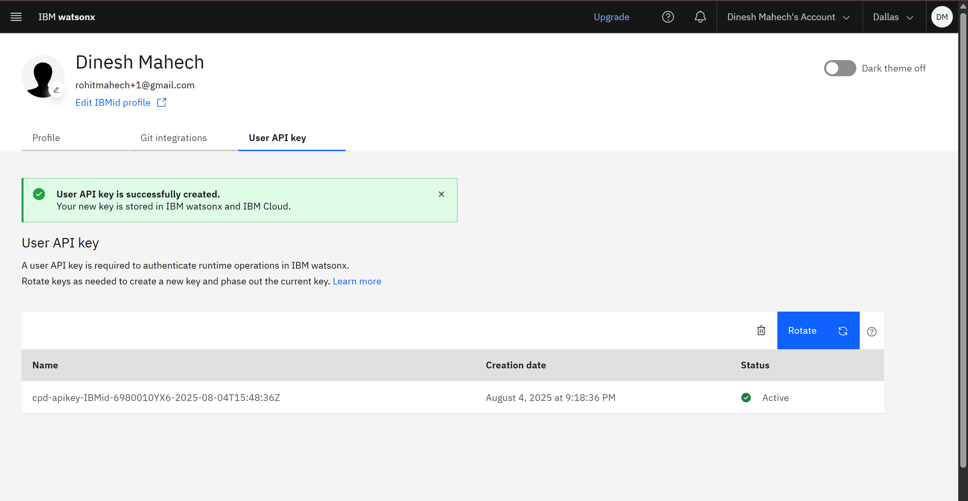
Results

Slide 11
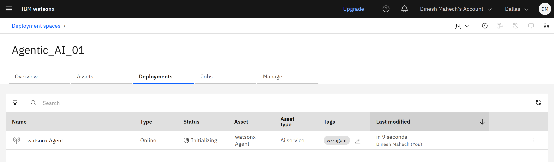
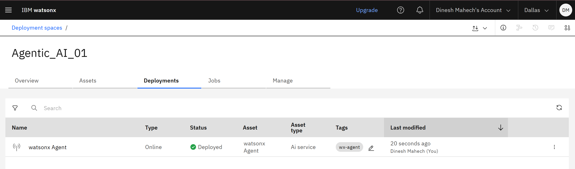
Results

Slide 12
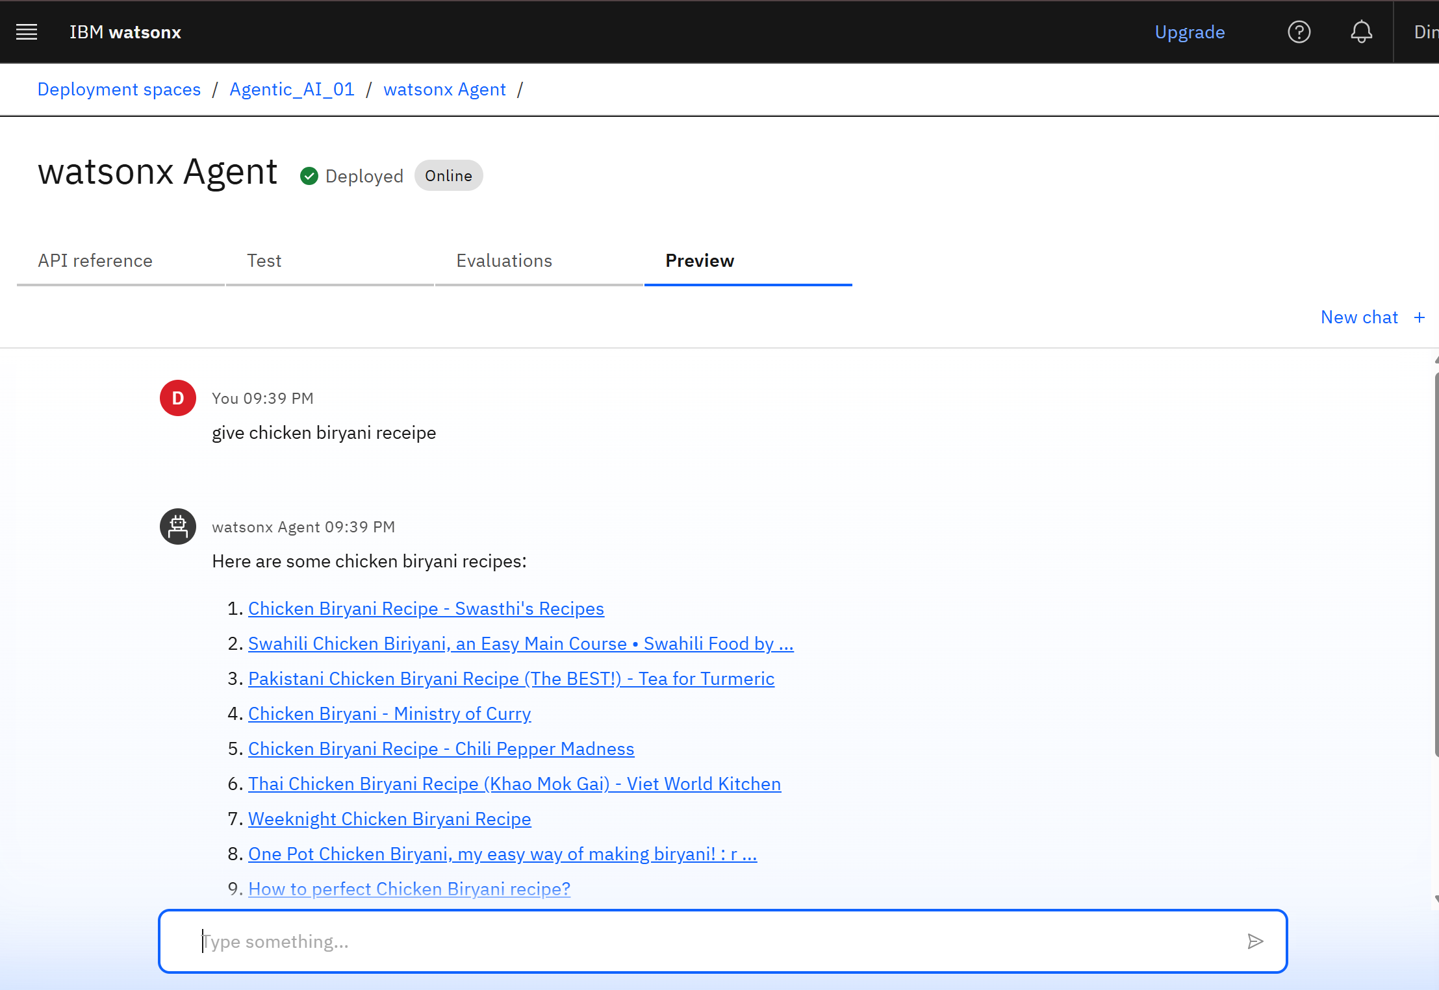
Results

Slide 13
Conclusion
The Travel Planner Agent simplifies the trip planning experience by combining the power of AI and IBM Cloud services. It offers personalized itineraries, integrates real-time data like weather and transport, and delivers a seamless interaction through a smart assistant.
This project demonstrates the effective use of:
Watson Assistant for conversational AI
IBM Code Engine for deployment
The agent enhances the travel experience by saving time, improving decision-making, and reducing manual effort — all in a cloud-native, scalable way.

Slide 14
Future scope
🔗 Live Booking Integration
Integrate APIs for real-time flight, hotel, and transport bookings
🌐 Multilingual Support
Allow users to interact in different languages for wider accessibility
🚦 Live Traffic & Delay Updates
Integrate live traffic data to update routes and timings dynamically
🧳 Trip Sharing & Collaboration
Let users share and collaborate on plans with friends or family

Slide 15
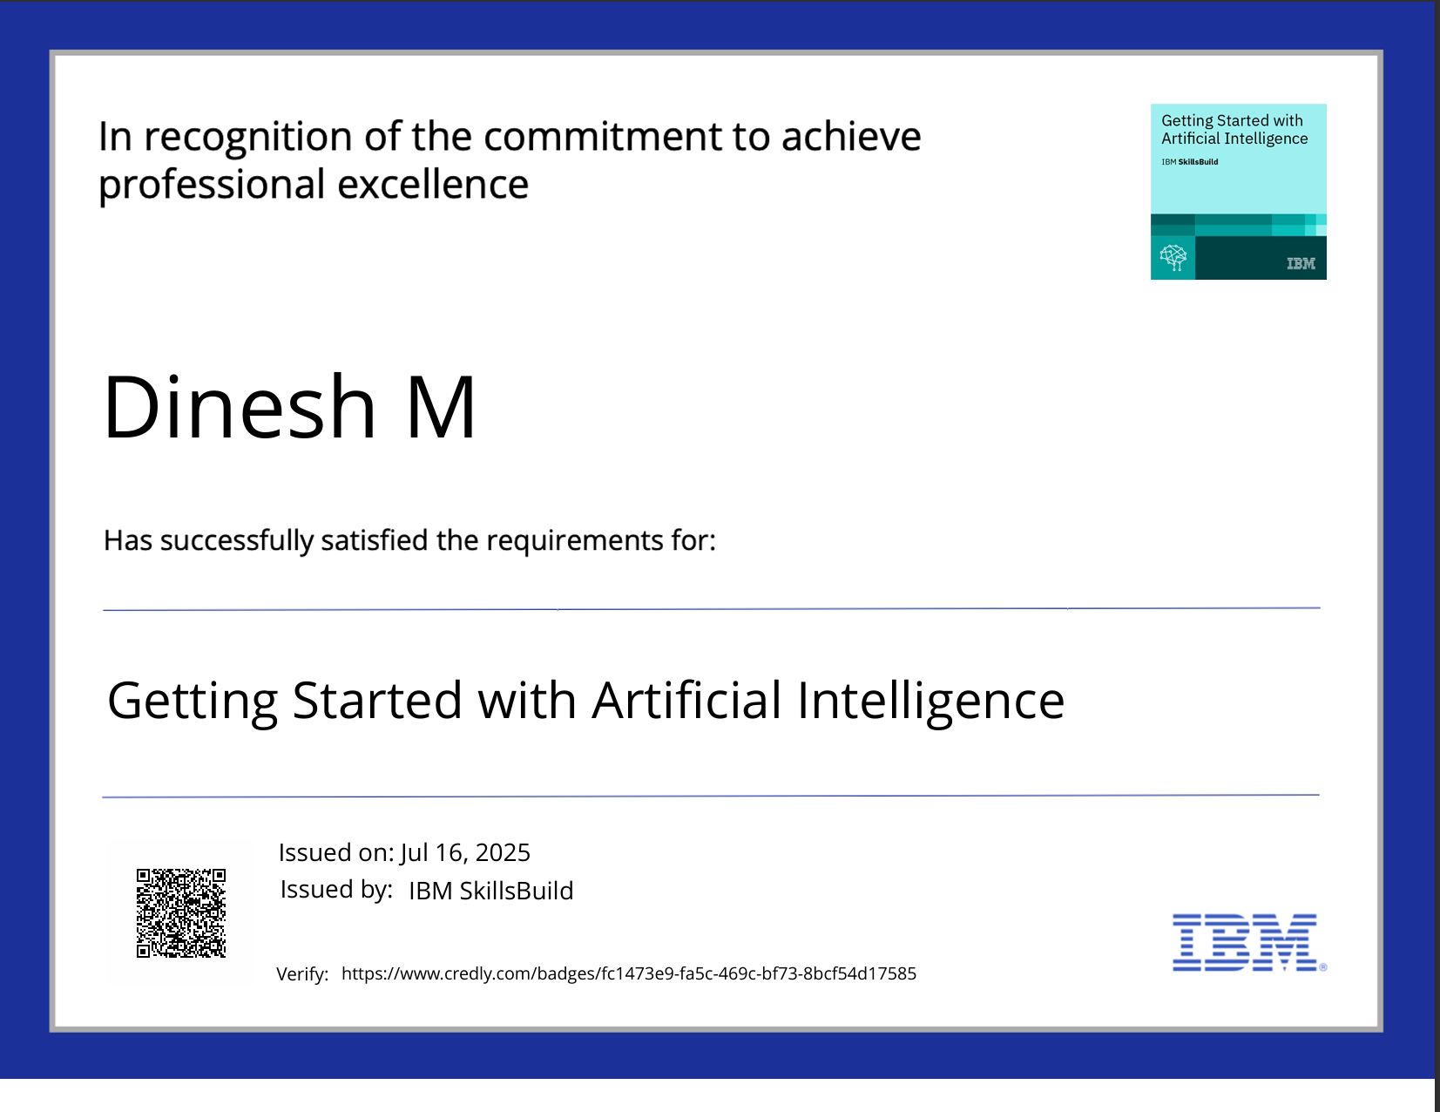
IBM Certifications
Screenshot/ credly certificate( getting started with AI)

Slide 16
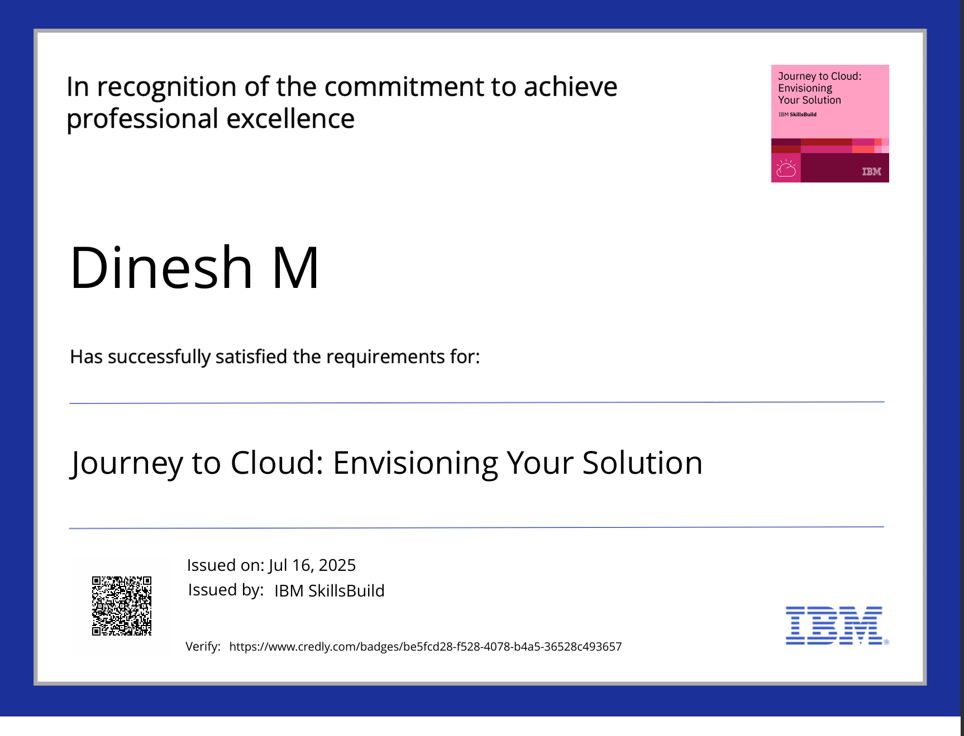
IBM Certifications
Screenshot/ credly certificate

Slide 17
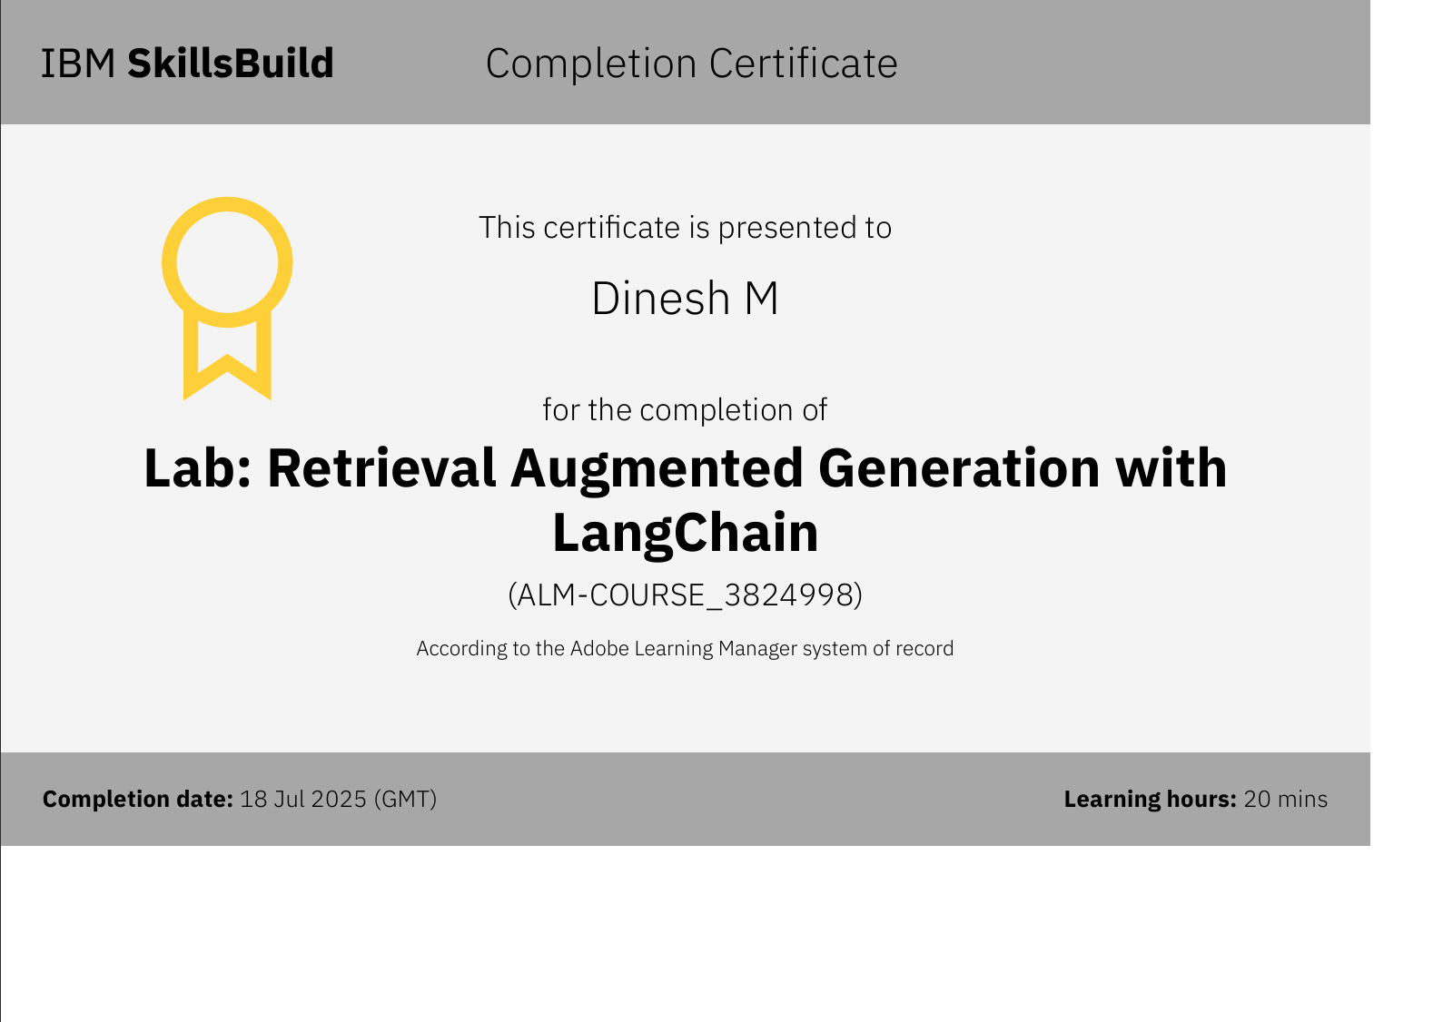
Attach your RAG LAB certificate here

Slide 18
GitHub Link
Make sure that there should be readme file
GITHUB LINK : https://github.com/DineshMahech/Travel_Planner_AI_Agent_IBM_Cloud_Project.git

Slide 19
THANK YOU

